Slide 1
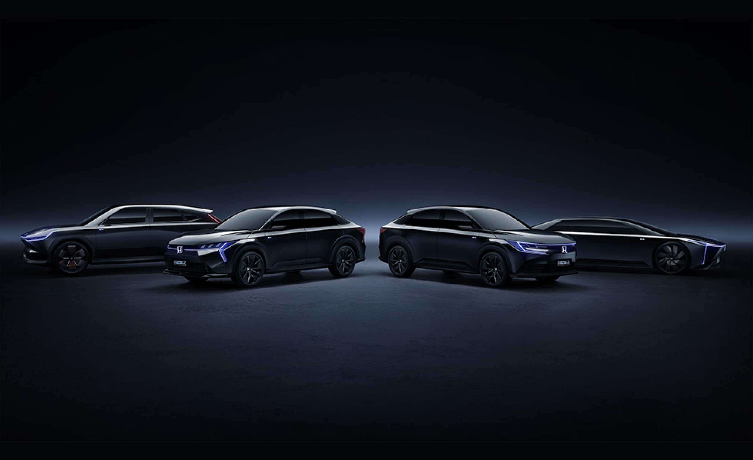
The Future of Electric Vehicles:
A Glimpse into 2050
Electrifying the Road to Net Zero
Dec 1, 2023
Data Nerds

Slide 2

What 2050 EV will be like?
BEV (Battery Electric Vehicle)
will dominate the future market.
Electrifying the Road to Net Zero - Dec 1, 2023
Data Nerds

Slide 3
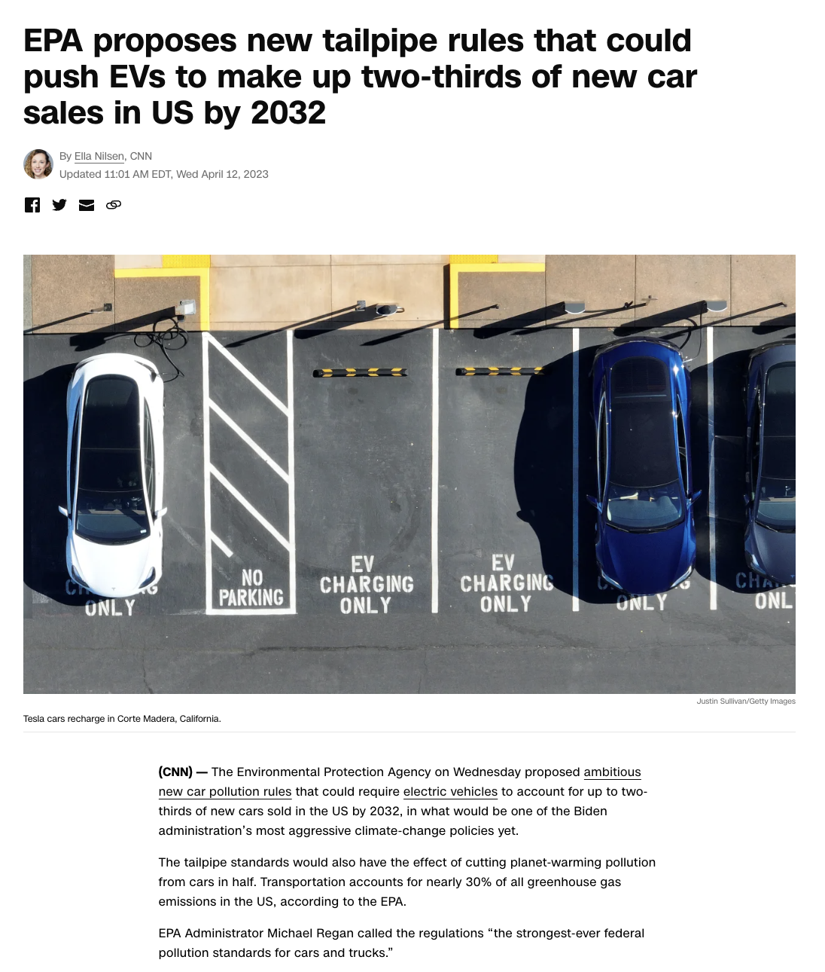
What 2050 EV will be like?
BEV (Battery Electric Vehicle)
will dominate the future market.
1. Alignment with regulation
BEV is aligned with both Paris Agreement and US Environmental Protection Agency.
2. Growing significance
3. Sustainability
4. Cost effectiveness
Electrifying the Road to Net Zero - Dec 1, 2023
Data Nerds

Slide 4
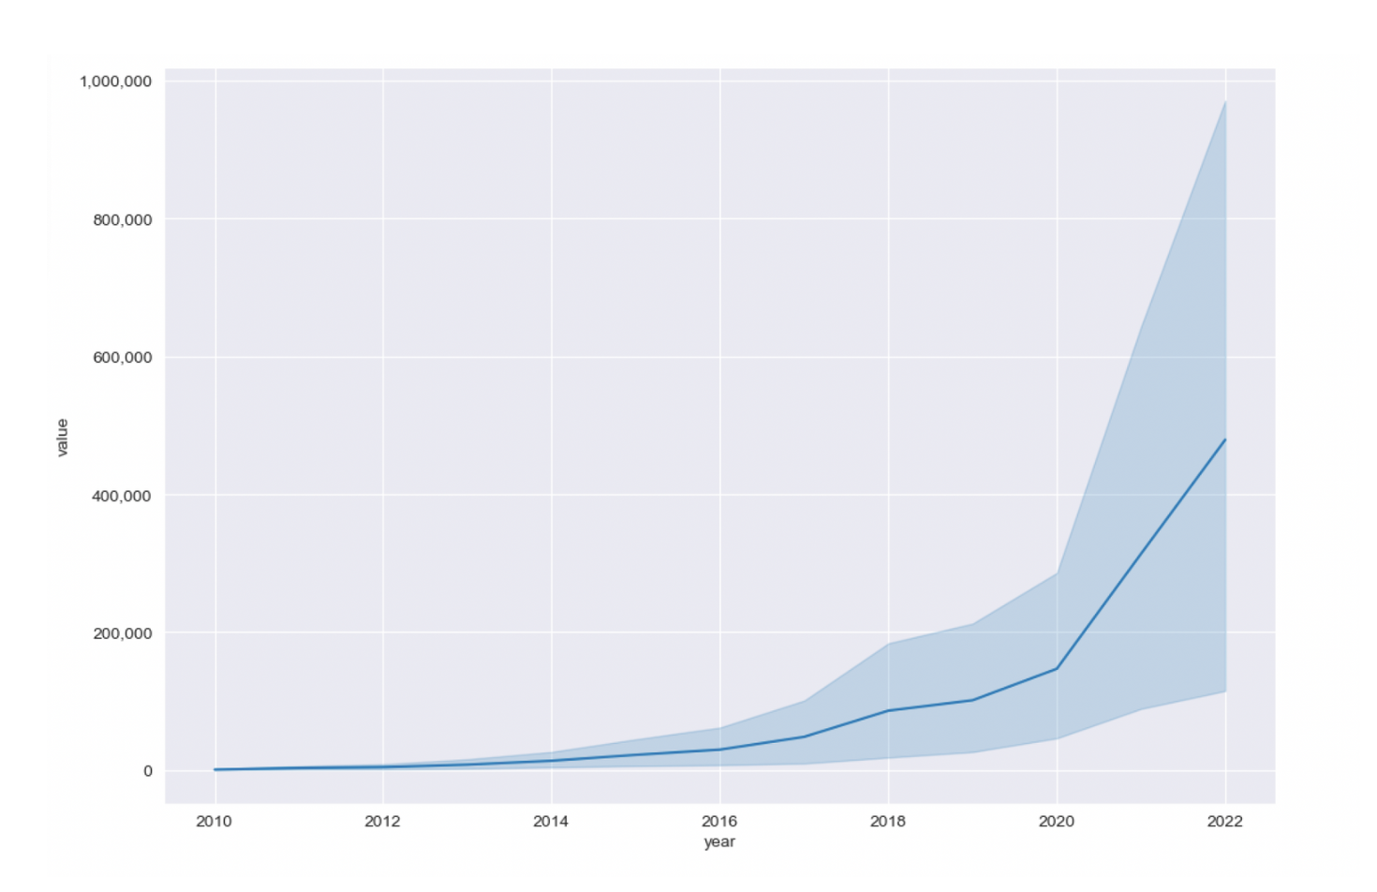
What 2050 EV will be like?
BEV (Battery Electric Vehicle)
will dominate the future market.
EV market sales since 2020
1. Alignment with regulation
2. Growing significance
We can observe a rapid increase in EV sales since 2020, and this trend is expected to continue with even higher sales numbers in the future.
3. Sustainability
4. Cost effectiveness
Electrifying the Road to Net Zero - Dec 1, 2023
Data Nerds

Slide 5
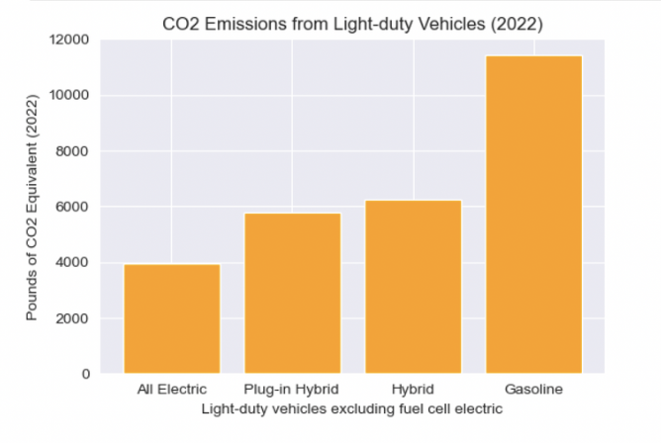
What 2050 EV will be like?
BEV (Battery Electric Vehicle)
will dominate the future market.
CO2 Emissions from different types of vehicles
1. Alignment with regulation
2. Growing significance
3. Sustainability
By utilizing the data provided by the U.S. Department of Energy, the bar chart illustrates that EVs generate the lowest amount of CO2 equivalent per year.
4. Cost effectiveness
Electrifying the Road to Net Zero - Dec 1, 2023
Data Nerds

Slide 6
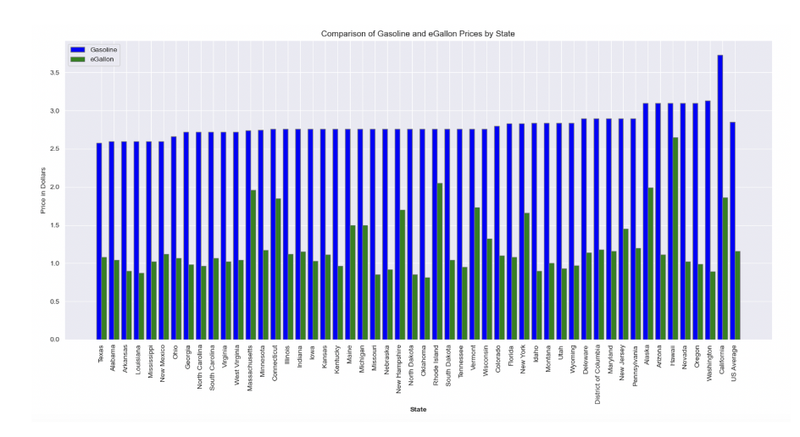
What 2050 EV will be like?
BEV (Battery Electric Vehicle)
will dominate the future market.
Average price of a gallon of Gasoline and an eGallon
1. Alignment with regulation
2. Growing significance
3. Sustainability
4. Cost effectiveness
The national average cost of “fuel” for an electric vehicle” is about 60% less than for a gasoline vehicle
Electrifying the Road to Net Zero - Dec 1, 2023
Data Nerds

Slide 7
Driving the Future: ELECTRIFY, where Innovation Meets the Road
ELECTRIFY
PRESENTED BY DATA NERDS

Slide 8
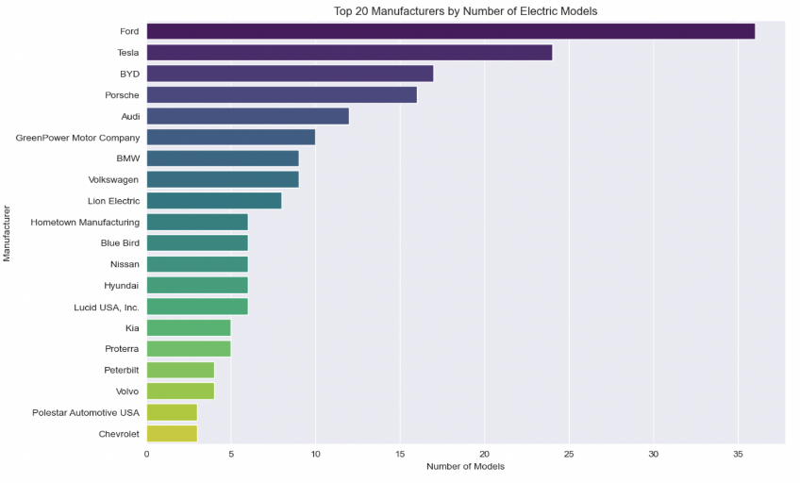
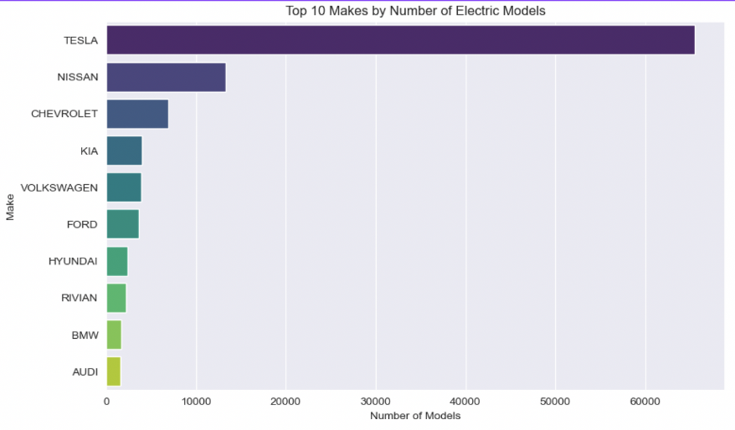
INTRO
DATA ANALYSIS
SOLUTIONS
Market Landscape
Tesla and Ford's dual leadership in manufacturing and sales
underscores the effectiveness of their strategies.
Top 20 Battery Electric Vehicle
Manufacturers in the US
Top 10 Battery Electric Vehicle
Sellers in Washington State

Slide 9
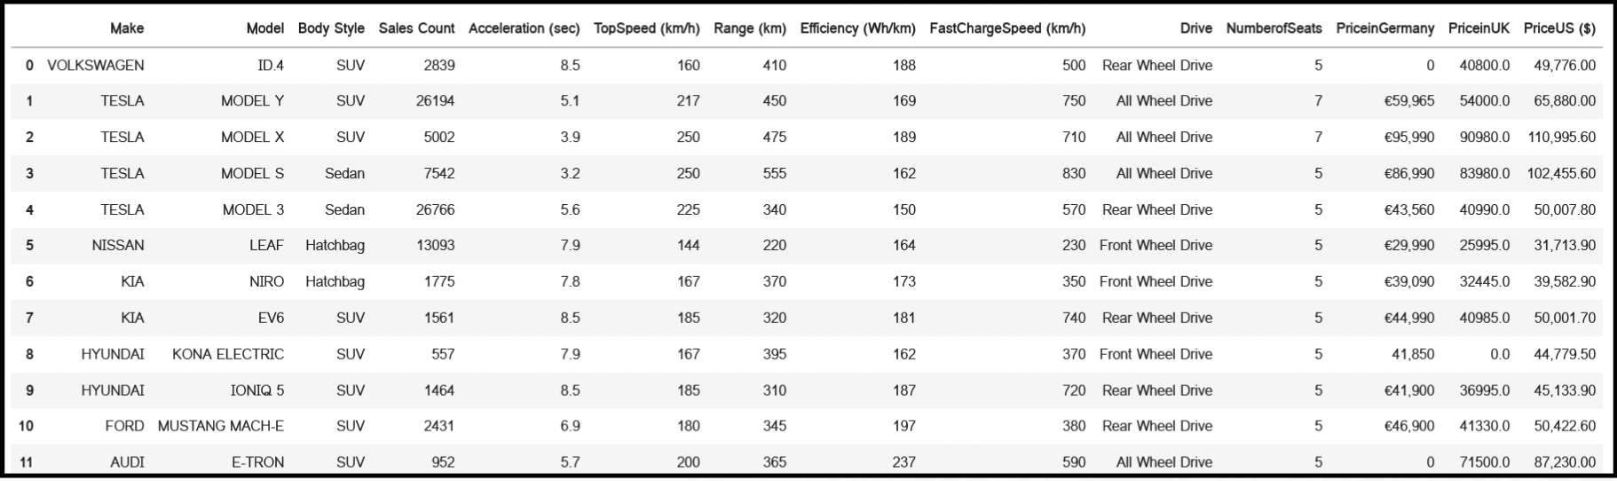
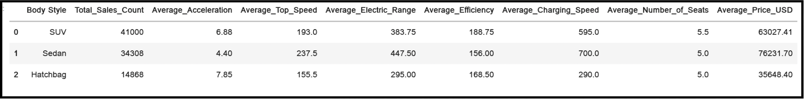
INTRO
DATA ANALYSIS
SOLUTIONS
Customer Preference
Specific feature for each body type
and aggregated values guide our EV market strategy.
Integrated ‘Feature’ dataset with Top 10 Sellers EV models (>500 units sold)
to identify BEV benchmarks and customer preferences

Slide 10
INTRO
DATA ANALYSIS
SOLUTIONS
Customer Preference
Specific feature for each body type
and aggregated values guide our EV market strategy.
SUV
Sedan
Hatchback
Avg Acceleration
6.88
4.44
7.85
Avg Top Speed
193
237.5
155.5
Avg Electric Range
383.75
447.5
295
Avg Efficiency
188.75
156
168.5
Avg Charging Speed
595
700
290
Avg Number of Seats
5.5
5.0
5.0
Avg Price
63,027.41 USD
76,231.70 USD
35,648.40 USD

Slide 11
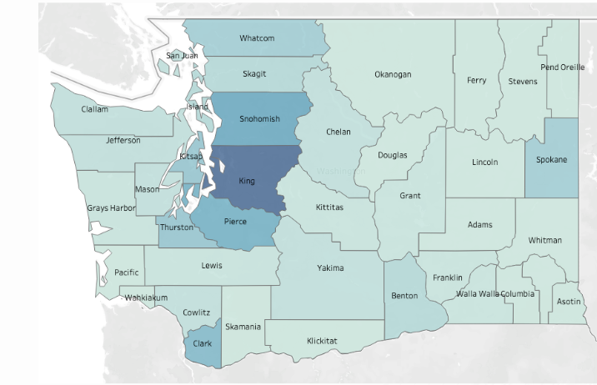

INTRO
DATA ANALYSIS
SOLUTIONS
Charging Station
Correlation: more stations lead to
greater consumer interest and sales.
Population of EVs per County in Washington
Population of EV Public Charging Stations per County in Washington

Slide 12
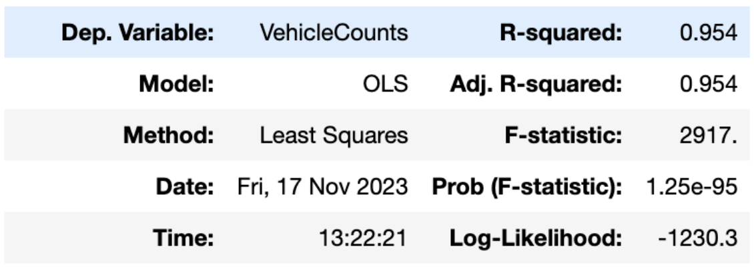
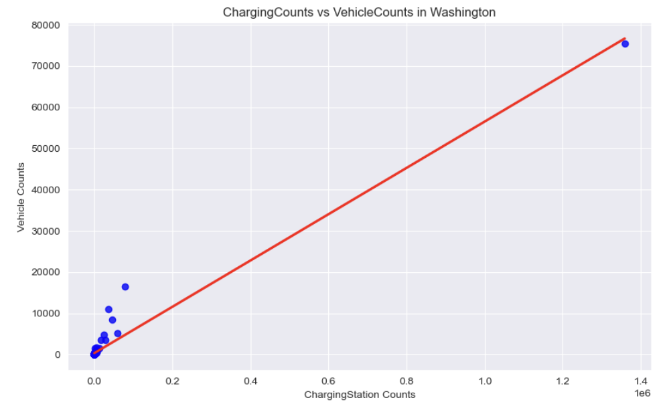
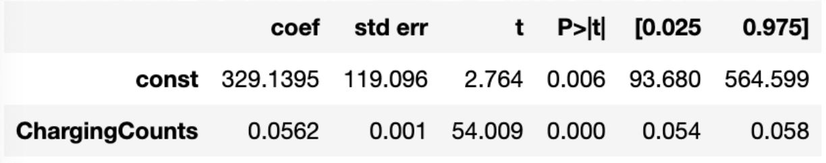
INTRO
DATA ANALYSIS
SOLUTIONS
Charging Station
There is a direct correlation between the prevalence of
charging stations and the number of EV owners.
P-values indicate a statistically significant correlation
between Charging Counts and Vehicle Ownership.

Slide 13
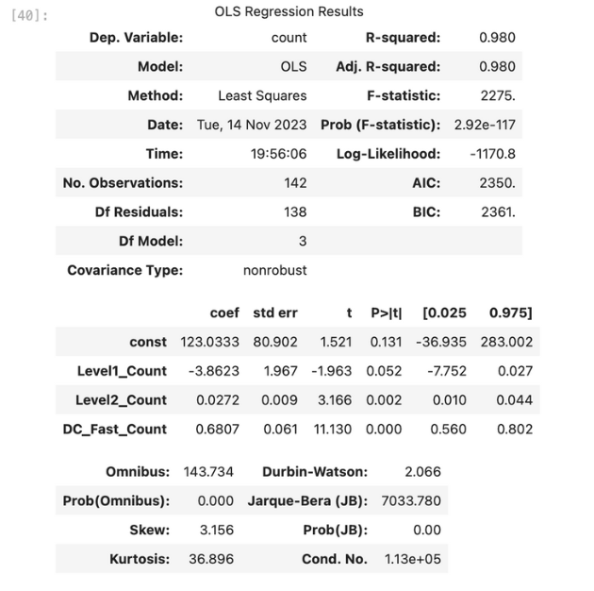
INTRO
DATA ANALYSIS
SOLUTIONS
Charging Station
Regions with more Level 2 & DC Fast chargers show increased BEVs,
significantly influencing sales in Washington.
This trend is likely applicable across the U.S., based on extensive Washington data.

Slide 14
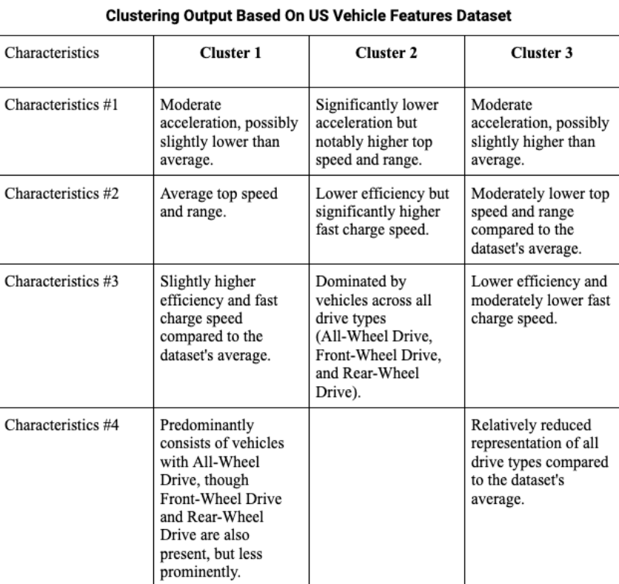
INTRO
DATA ANALYSIS
SOLUTIONS
Cluster Analysis
These clusters illuminate the inherent groupings observed in most BEV cars within the broader US automotive market.
Cluster 1
Cluster 2
Cluster 3
Balanced Performance & Fast-charging
Modest Performance with Varied Drive Types
Diverse High Speed & Range

Slide 15
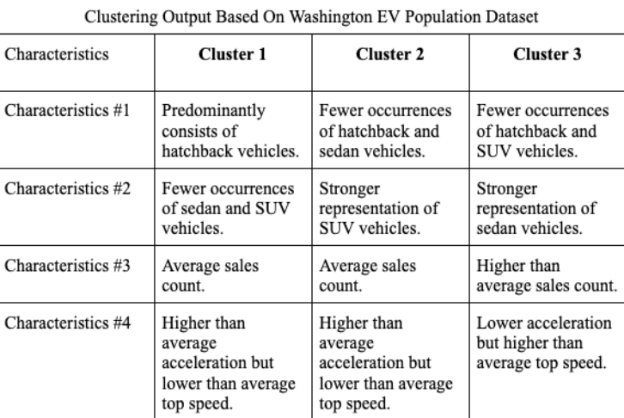
INTRO
DATA ANALYSIS
SOLUTIONS
Cluster Analysis
This delineation elucidates the inherent clusters existing
within the Washington automotive market.
Cluster 1
Cluster 2
Cluster 3
Hatchbacks
SUVs
Sedans
Higher acceleration and lower top speed
Higher acceleration but lower top speeds
Lower acceleration but higher top speeds

Slide 16
Driving the Future: ELECTRIFY, where Innovation Meets the Road
SOLUTION
PRESENTED BY DATA NERDS

Slide 17
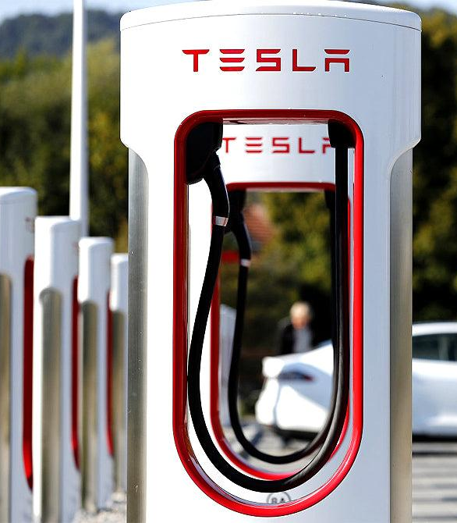
INTRO
DATA ANALYSIS
SOLUTIONS
01
Utilizing Benchmarks as A Proxy for Entry
Tesla, excelling in both production and sales, sets a benchmark for EVs with its extensive Supercharger network and customer-focused innovations like online customization and software updates, providing key strategies for competitive market entry.

Slide 18
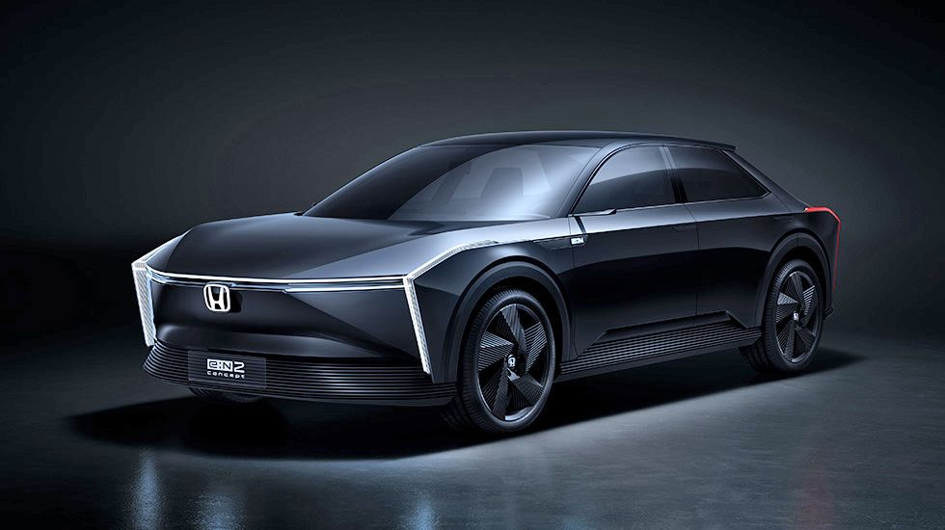
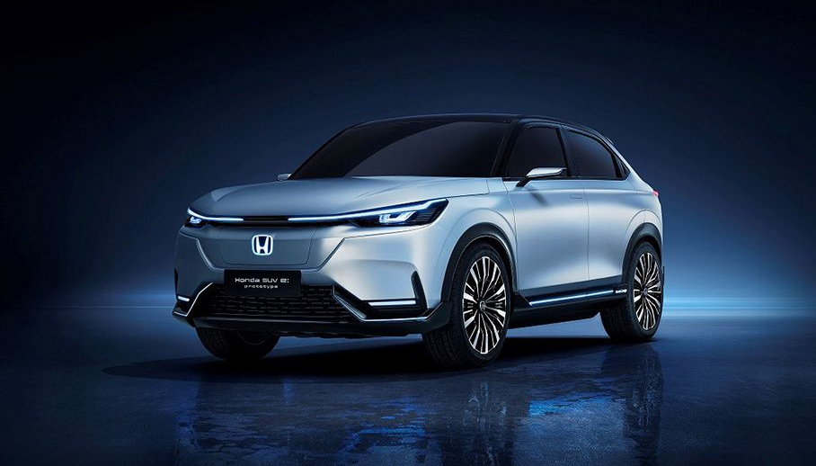
INTRO
DATA ANALYSIS
SOLUTIONS
02
Strategies Based on Different Vehicle Body Types and Their Features
SUVs as sales leaders due to their efficiency and family appeal, Sedans attract a performance-oriented, wealthier customer base, while Hatchbacks present growth opportunities in the budget-conscious segment, collectively providing our client with comprehensive market insights for future product development.

Slide 19
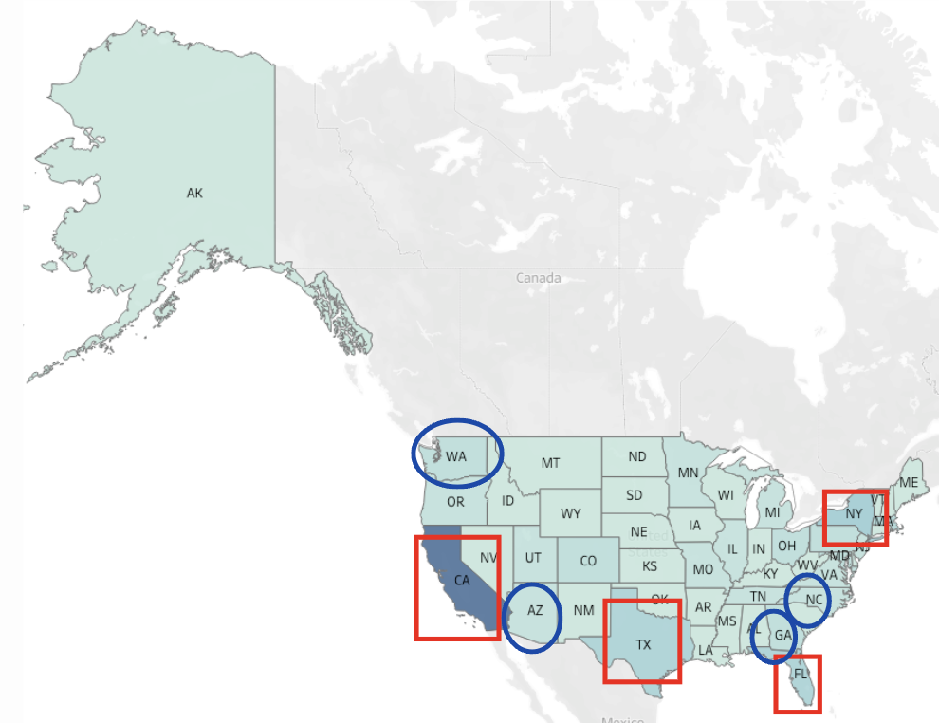
INTRO
DATA ANALYSIS
SOLUTIONS
03
Strategic Targets for Vehicle Sales and Charging Infrastructure Investment
The analysis shows a strong link between charging station availability and EV ownership, suggesting states with developed infrastructure like California, Texas, Florida, and New York as ideal markets for EV sales. For long-term strategy, we propose pioneering infrastructure development in regions with high growth potential but lacking facilities, laying the groundwork for our expansive EV network.

Slide 20

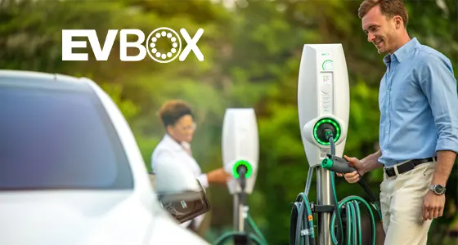
INTRO
DATA ANALYSIS
SOLUTIONS
04
Strategic Alliance Formation with Suppliers and Traditional Manufacturers
We advise Electrify to form alliances with established vehicle manufacturers, leveraging their expertise and resources to boost manufacturing capabilities and scalability. This collaboration can reduce entry costs, easing access to the BEV market. Additionally, we recommend strategic partnerships with key suppliers, particularly in areas like lithium-ion batteries and charging stations, offering competitive advantages and profit potential for all parties involved.

Slide 21




INTRO
DATA ANALYSIS
SOLUTIONS
05
Maximizing Company Visibility through Participation in Industry-Specific Conventions
By attending events and conventions popular among battery electric vehicle manufacturers, our customer can effectively promote their brand, connect with key industry players, and keep up-to-date with the latest trends and technologies in the BEV market.

Slide 22
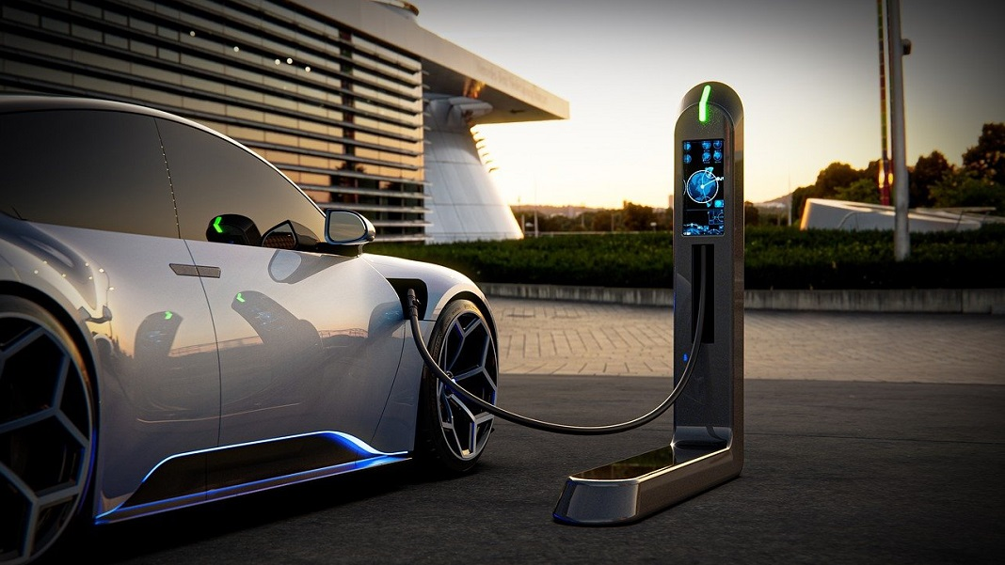
Our Recommendations
01
Learning from the Industry Giants
02
Unveiling Market Dynamics Across SUVs, Sedans and Hatchbacks for Strategic Product Development
03
Leveraging Charging Infrastructure for
Optimal BEV Market Expansion
04
Fostering Strategic Alliances and Partnership for
BEV Market Success
05
Elevating Brand Impact Through Strategic Participation in BEV Industry Events

Slide 23
Thank you!
Electrifying the Road to Net Zero
Dec 1, 2023
Data Nerds

